Slide 1

Backdoor – The Spyman
Submitted in the partial fulfillment for the award of
the degree of
BACHELOR OF ENGINEERING
IN
Computer Science-Information Security
Under the supervision of
Monica Luthra
Submitted by:
Pranav Gupta, 20BCS3703
Akul Sharma, 20BCS3675
Syed Mohd Arsh Mehdi Rizvi, 20BCS3713
DISCOVER . LEARN . EMPOWER

Slide 2
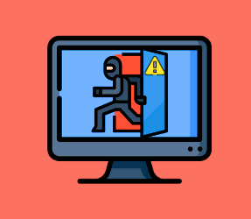
Outline
Introduction
Problem Formulation
Objectives
Requirements
Methodology
Output & Results
Conclusion
Scope in Future
References

Slide 3

Introduction
While performing a burglary, a thief takes advantage of the vulnerabilities of the house and get entry into it, bypassing the security. Backdoor attack on the computer system is quite similar.
In cybersecurity terms, a Backdoor attack is a malicious
way to bypass the security and infiltrate computer
devices. Like the actual theft, a Backdoor attack allows
The cyberattacks to go in and out of the system without being discovered by the security system of
the device.

Slide 4
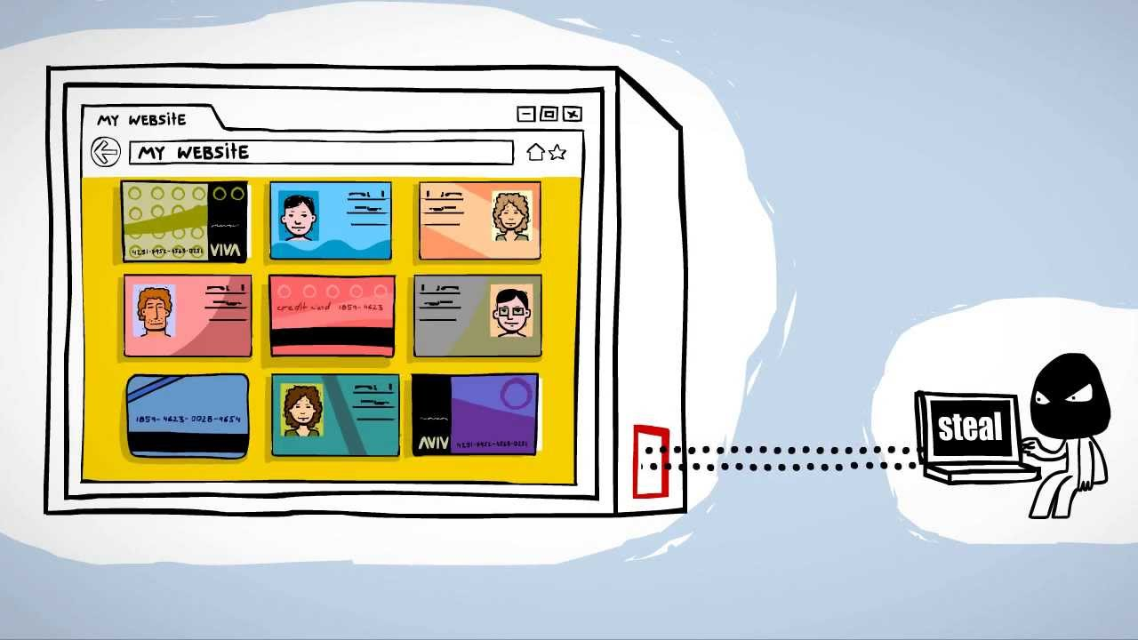
After the backdoor entry into the system,
cybercriminals can get high-level access to
the system and control it. Once control is
taken, the attackers can freely perform the
intended malicious tasks like gaining
remote access, introducing additional
malware, hacking the system, steal personal
and financial data, and many more.
However, the same Backdoor might also be beneficial. We live in a technologically advanced age where we store all of our private information on our gadgets, just like our adversaries, be they terrorists or a rival group, do. Therefore, we have decided to create a backdoor to aid our government or cyber army in quickly obtaining all the data and their plans.

Slide 5
Problem Formulation
It can be used to gather information about potential terrorist or cyber attacks.
It can support police investigations and crime-solving efforts.
The army can utilize it to track down their adversaries and acquire intelligence so they can be ready and take appropriate actions.
It can be used to find out if someone is leaking sensitive information that could jeopardize national security.

Slide 6

Objectives
The Main Objectives of this project are as follows:
To obtain important credentials of adversary.
To know intentions of adversary.
Prediction of future attacks.
To gain intelligence against the adversary

Slide 7
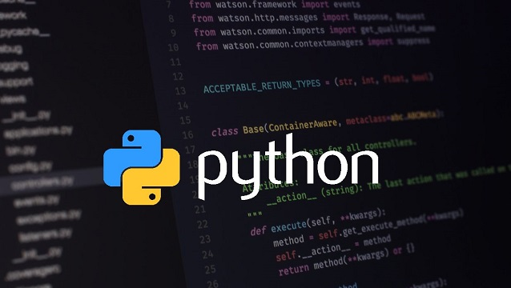
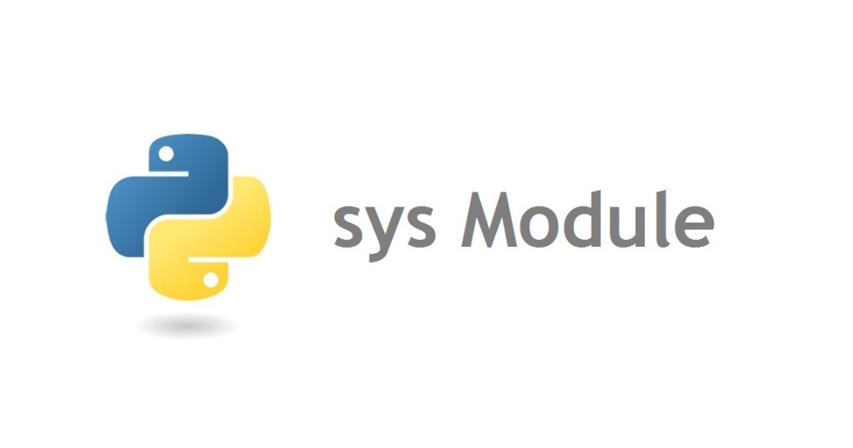
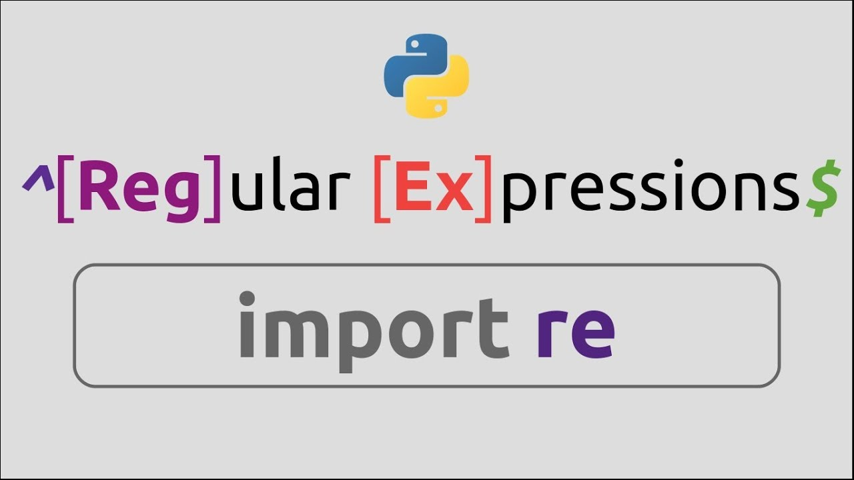

Requirements
Various requirements for this project are as follows:
Libraries Used:
Sys
Requests
Socket
Time
Cryptography
Software’s Required:
Python IDLE
Terminal/Windows PowerShell.

Slide 8
Methodology
When building a backdoor, there are two components needed:
Client: These are the components that will be installed on the victim computer, initiates a connection to the attackers network, accepts commands and sends data to and fro.
Server: This is the component that will be installed on the attacker system acting as the entry point listening to the client connection, accepting the connection if it’s from the victim, sending commands and receiving data.
To make this work, we’ll be using the Socket module that comes built-in Python. The socket module is used to send data/messages to and fro over a network. In this case, the server will be sending commands (messages), the client receives a message (commands), sends a reply (data) and vice versa.

Slide 9
So we are going to be building two components: client.py and server.py.
client.py
We will import the modules we’ll be using – socket module (initiating our network connection) and subprocess (for running commands in shell)
Declare the attackers (our) remote REMOTE_HOST and REMOTE_PORT. Update the REMOTE_HOST with your IP or localhost.
Create the socket connection for client and connect it to our REMOTE server
Then we will add a while loop, that keeps listening and waiting for messages or commands
We will extract the message from .recv(1024), decode it to a string and pass it to the subprocess program responsible for running the command.
After running the command, we will check for both output and error, then send both along over the network.

Slide 10
server.py
We will import the socket module (for listening and accepting network connection)
Declare our HOST and PORT. Update the HOST with your IP or localhost.
Create the socket connection, listen to incoming connection and accepting, if any (when the user runs the program).
We will create a while loop to maintain connection between the client and server components.
From here we can then ask the attacker to enter a command, send the command and get a response sent by the client component.
To test this, you will need to run the two components simultaneously and connected to the same HOST and PORT.

Slide 11
Output & Results
Once you have successfully created the two components, we now have a simple backdoor software written with Python.
To test this, you will need to run the two components simultaneously and connected to the same HOST and PORT.
Open two terminals or command line and then run each command on each terminal.
Server: python server.py
Client: python client.py

Slide 12
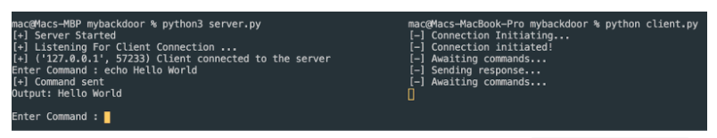
If you see outputs like the one in the image above, then both the server and client are connected and waiting to send and receive messages.
The server is ready to send commands while the client is ready to receive commands, run it and send back its output.
Now let’s enter this command in the server terminal: echo Hello World:
You should see something like the above image. We sent the command echo Hello World which means it should print out Hello World in the terminal. The client receives this command, runs it and sends back a response that is the output of the command.

Slide 13
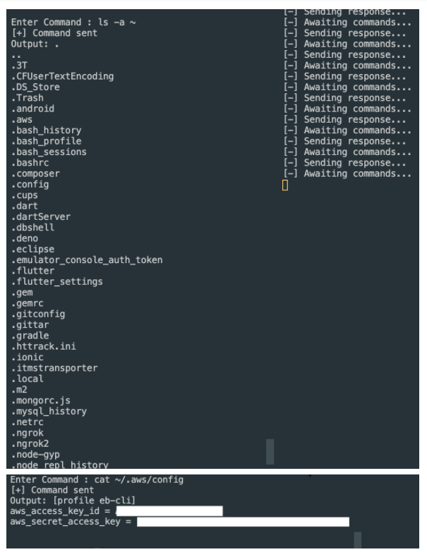
Let’s try another like: ls -a ~, cat ~/.aws/config
You can literally steal the user’s AWS access_key and access_id without their knowledge. Not only that, you can also run dangerous and do all sorts of things with this simple backdoor program.
With this, we can conclude that we have compromised the user computer and are able to gain access to the user computer and steal data.

Slide 14
Conclusion
We have explained what a backdoor is, how innocent-looking and dangerous it could be and how to build one. These kinds of programs are a big threat because it’s hard to detect them as they’re hidden in a simple program and can look like normal software. Most backdoor programs are bundled as .dll in Windows, or binary or packaged in Python GUI frameworks like Kivy.
Don’t use this to gain unwanted access to any computer without permission because it is illegal. Do not use this program for any illegal reasons even though it’s in its simplest form.

Slide 15
Future Scope
It can be used to gather information about potential terrorist or cyber attacks.
It can support police investigations and crime-solving efforts.
The army can utilize it to track down their adversaries and acquire intelligence so they can be ready and take appropriate actions.
It can be used to find out if someone is leaking sensitive information that could jeopardize national security.

Slide 16
References
International Journal of Artificial Intelligence & Applications (IJAIA), Vol.3, No.4, July 2012173Networks,” IEEE Proceedings of the 9th International Conference on Neural InformationProcessing, Singapura.
Joseph J. LaViola Jr., (1999). “A Survey of Hand Posture and Gesture Recognition Techniques andTechnology”, Master Thesis, Science and Technology Center for Computer Graphics and ScientificVisualization, USA.
Rafiqul Z. Khan, Noor A. Ibraheem, (2012). “Survey on Gesture Recognition for Hand ImagePostures”, International Journal of Computer And Information Science, Vol. 5(3), Doi:10.5539/cis.v5n3p110
Thomas B. Moeslund and Erik Granum, (2001). “A Survey of Computer Vision-Based HumanMotion Capture,” Elsevier, Computer Vision and Image Understanding, Vol. 81, pp. 231–268.

Slide 17

Thank You

